Slide 1
Horizon Electric Manpower Scheduling Board
University of British Columbia Okanagan Campus COSC499 - August 17th, 2023
Adam Fipke
Jordan Roberts
Eddy Zhang
Edwin Zhou
Yuan Zhu
Notes:
---EDWIN---
Hello, thank you for joining us for this presentation today. We are the capstone group that is responsible for developing a manpower scheduling board for Horizon Electric Inc.
---INTRODUCE YOUR NAMES---
Next: Edwin, introduce client

Slide 2
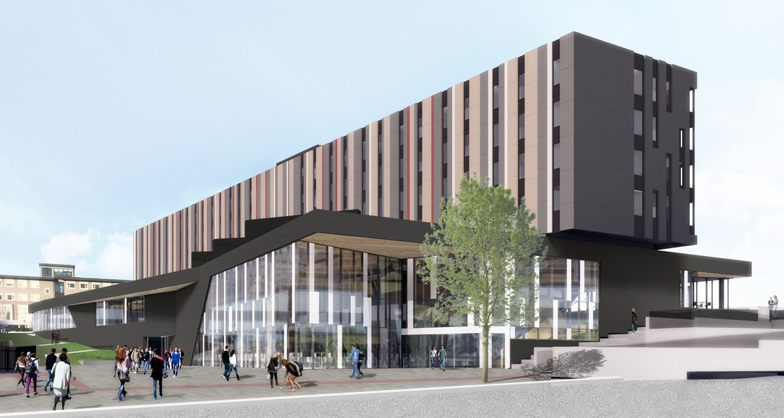
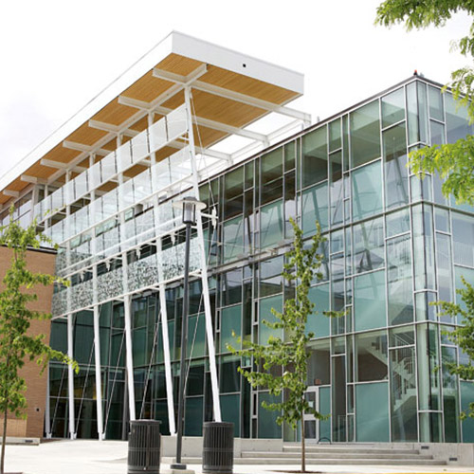
Client - Horizon Electric
Full service electrical contractor
Worked on projects such as Nechako and the RHS building at UBCO
Notes:
---EDWIN---
Horizon electric is a full service electrical contractor that is based in Kelowna. They have previously worked on projects such as the Nechako and RHS buildings on campus as well as various other projects in the Okanagan region.
Next: Yuan, project overview

Slide 3
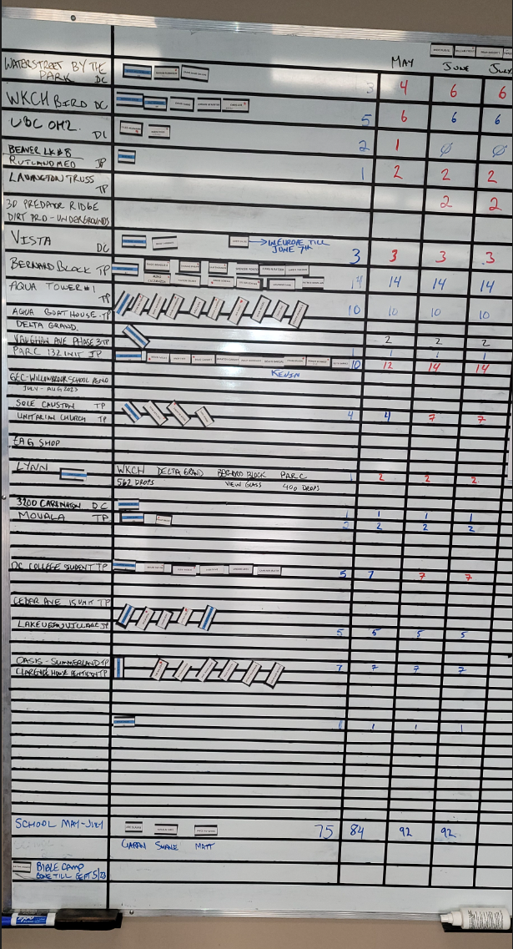
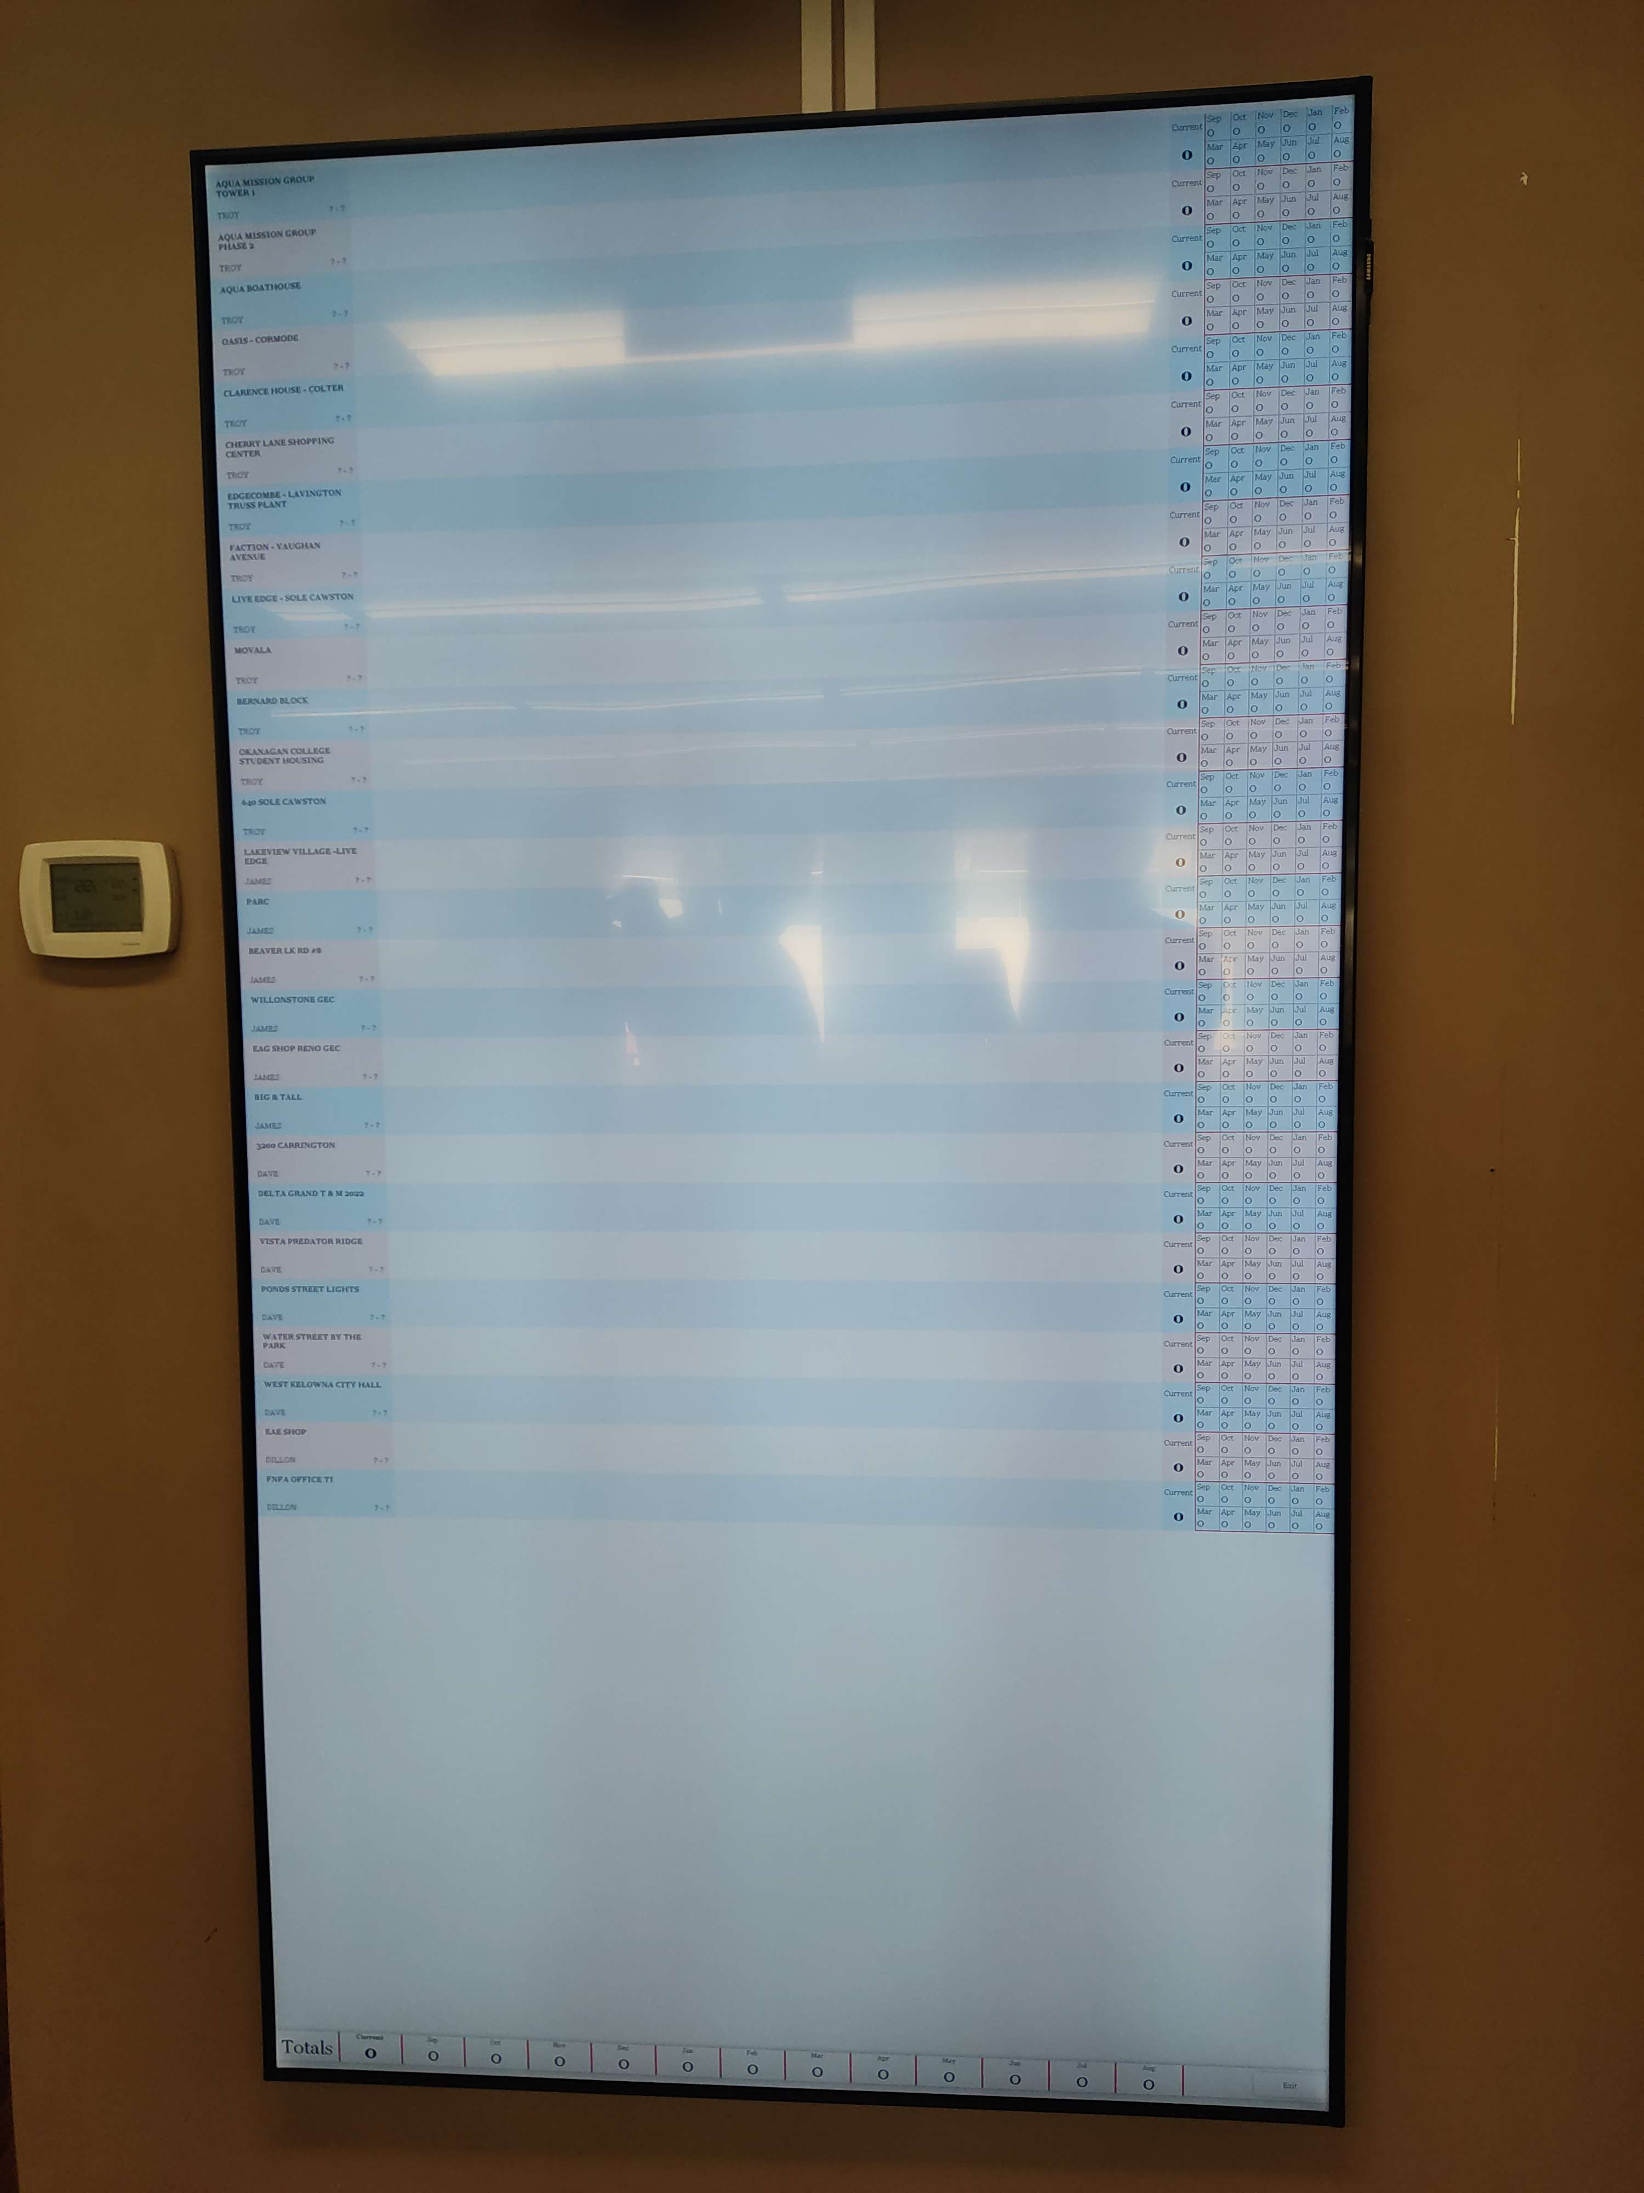
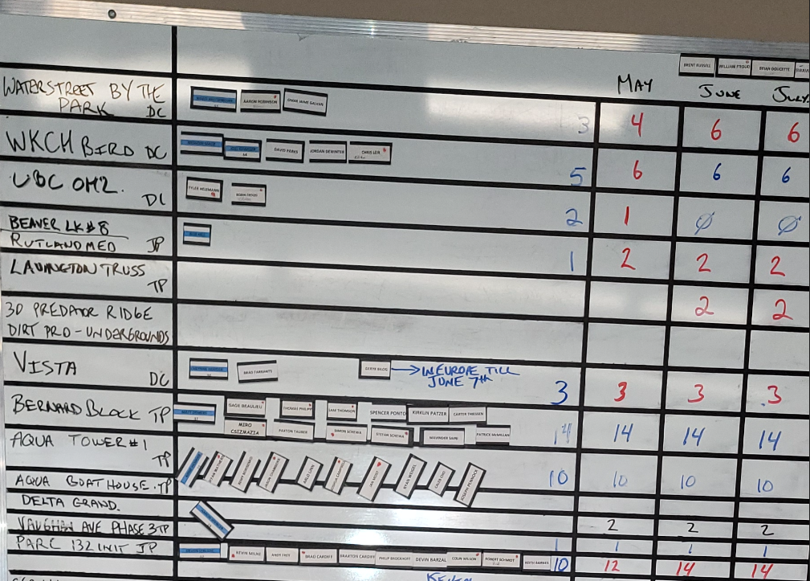
Project Overview
Before
After
Limited space
Hard to read
No history
Only 3 months of projection
Much more space
Organized
Automatic sums
Easily adjustable
12 months of projection
Notes:
Yuan
Horizon Electric, which employs over 100 employees, previously used a manual whiteboard system to keep track of their manpower and job assignments as you can see on the left. However, this system was inefficient and prone to human error. To modernize their system, Horizon Electric partnered with UBC to create a digitized version of their whiteboard system that retains its look and feel while improving efficiency and accuracy, which is what you see on the right.
Next: Yuan, distinguish feature

Slide 4
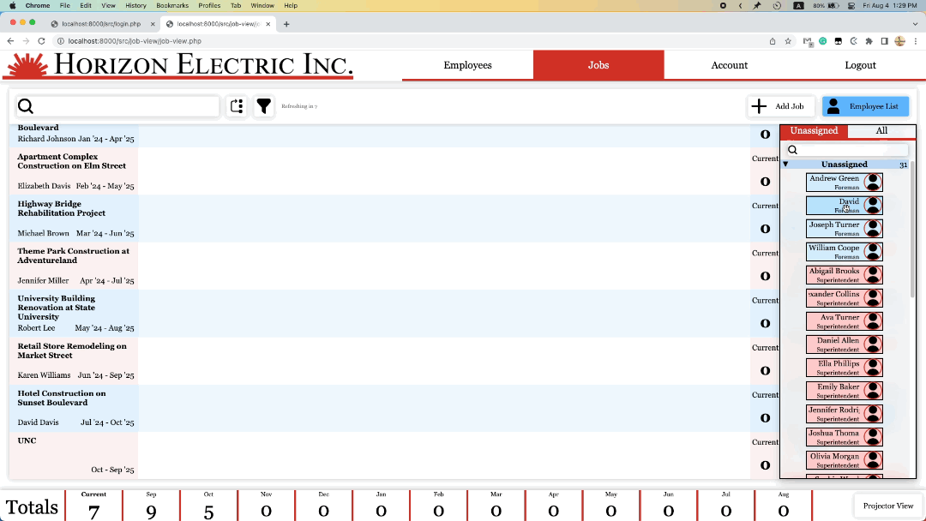
Distinguishing Feature
Notes:
Yuan
The most distinguishing feature is absolutely the drag-and-drop that we wrote from scratch.
When we were designing the system, the main priorities were to make it familiar, easy, intuitive to use, and responsive. To use the system, users drag and drop what we call “employee cards’ to make changes to the schedule. The employee counter and totals auto-update to make the previous manual task as automated as possible.
Now, we are going to move on to a video demonstration of the core features of our program
Next: Edwin, video demo

Slide 5
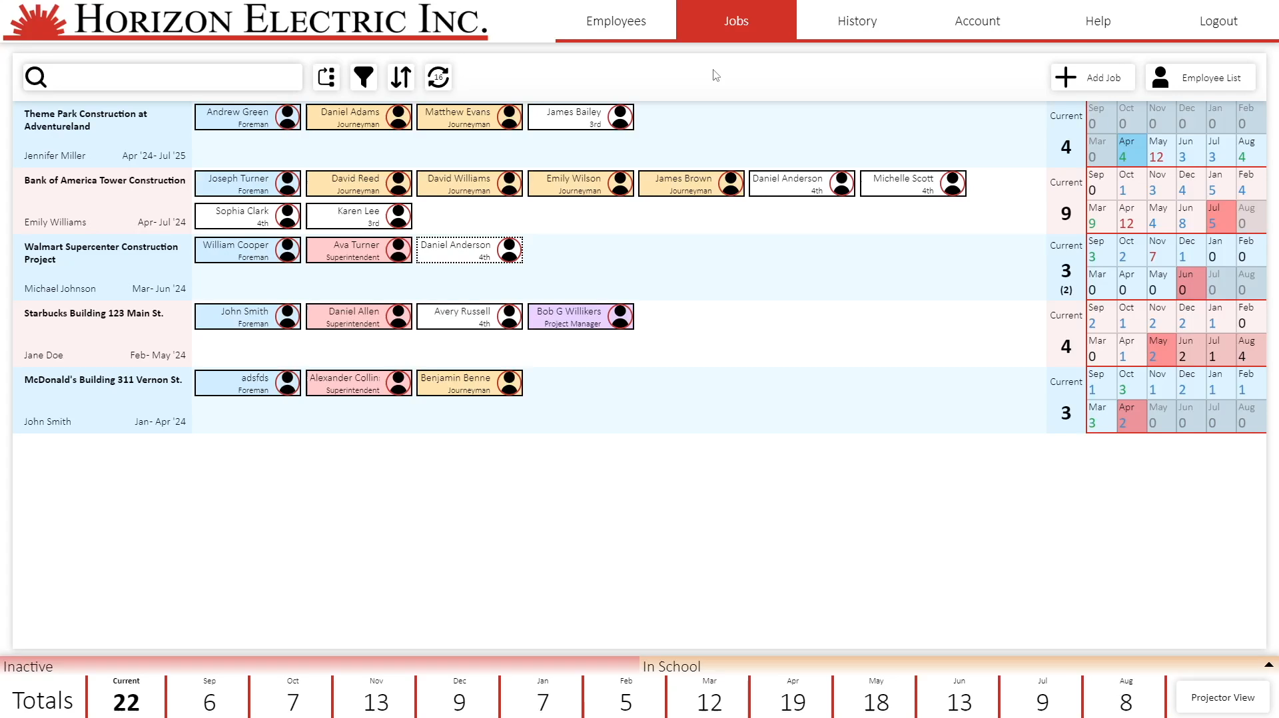
Notes:
Next: Edwin, software design section cover
---EDWIN---
Here is a brief overview of our system.
Each row on this page is a job. On the left we have the job name, project manager, and its start and end date.
In the middle we have all the employees currently assigned to that job.
And on the right we have the sum of currently working employees, as well as the manager’s future projections of how many employees they think they will need for the job
On the bottom of the page, the total number of employees working, as well as a total of the number of projected employees are shown.
To add a new job, we click the add job button, which brings up a form that we can fill. Once we are satisfied with the information, we click the save button which will save the job and open it's details.
On the details page, in addition to the basic information we can also view a graph that compares the number of projected employees to the actual number of employees that were historically assigned.
But, as you can see right now, there are no employees assigned to this job. To assign employees to jobs, we open the employee list on the right side of the job page and then simply drag the employee onto the job which will assign them. The managers at Horizon Electric also make projections of how many employees are expected to be working on a job in the future. They can edit the projected number by editing the values here on the right side of the page. As you can see, there is a highlight on the month of the projections that indicates the start and end of the job, as well as if the projections do not match the current number of assigned employees.
Other than those features, we can also search for particular jobs or employees assigned to a job. For example, if we search for John Smith the associated job pops up.
We are also able to archive jobs by opening the job details, enabling edit mode, and clicking the archive button. Once a job is archived, it will be available on the history page for future reference.
The last page that we would like to show in this demo is the employee page. On this page, we can see the entire list of employees in the system as well as the current status of those employees. To add a new employee, we simply click the add employee button and fill out the required fields. Here, we can also upload an employee image if we wish to. After saving, the system will open this employee's details to show that the add was successful. On this details page, we can enable the edit mode to edit the details of the employee such as their status or role.

Slide 6
Software Design
Notes:
Edwin
Now that you have seen a brief demonstration of the system in the previous video, let me introduce you to how we approached the design of the software.
Next: Edwin, user group 1

Slide 7
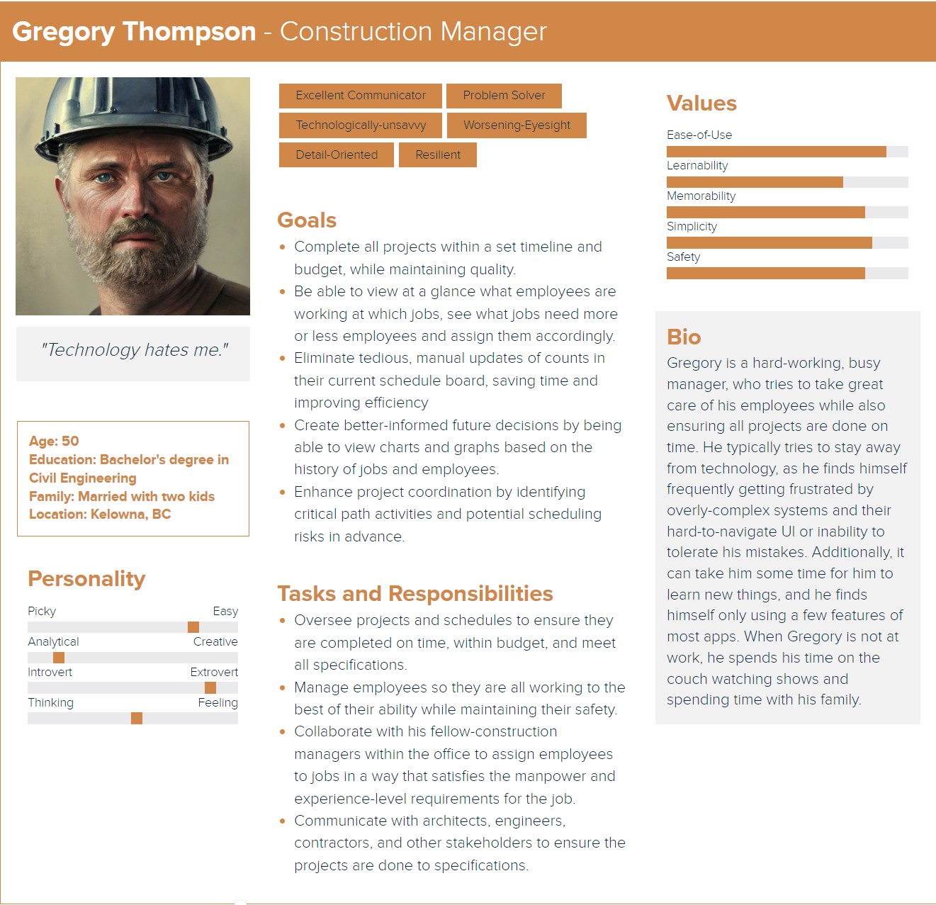
User Group
Notes:
Edwin
First, we made a sightly exaggerated persona of a typical construction manager. As you can see in this image, we imagined that a typical construction manager would wish for their managerial software to “just work” and that their focus would be to streamline their managerial tasks to make sure that their projects are completed on time and within budget.
Based off this persona, we identified two major design requirements for the project. First, the design of the project must be simple as construction managers are not interested in a system with confusing or complicated features, but rather a system that processes a few specific tasks really well.
Second, since this system would only be used infrequently, it needs to be easily learnable so that users do not need to memorize how to use the software.
Next: Edwin, user group 2

Slide 8
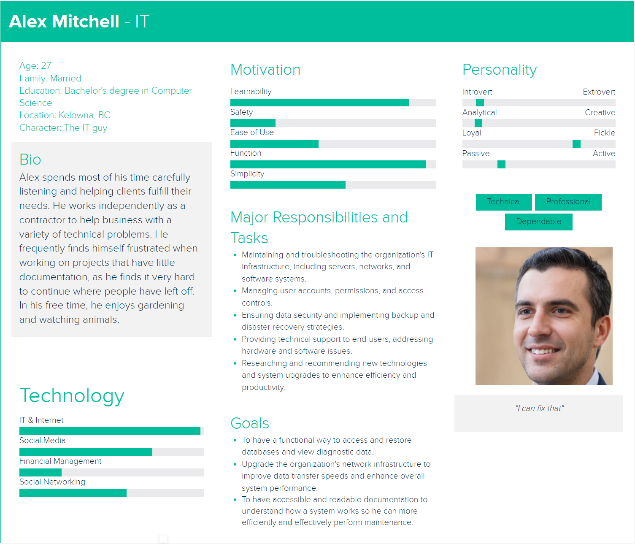
User Group
Notes:
Edwin
We also created a second persona of an IT admin who might be called in to manage, maintain, or fix the system if something does go wrong.
The main issue that we identified from creating an IT admin persona was that the admin might become frustrated if there was not enough documentation for a system that they were to maintain. As such, another requirement that we identified for the project was to make an admin-page where someone who was tasked to maintain the system can use to look up information about the system and execute tasks such as backup and restorations of the database.
Next, Adam will go over the use case and architecture diagrams

Slide 9
Key Requirements
Moving employees between jobs and between statuses
Adding, editing, and archiving employees
Adding, editing, and archiving jobs
Allowing for editing of predicted number of assignments
History of previous jobs and generated visual graphs
The UI must be intuitive and responsive for people who may not be the most familiar with technology
Notes:
---SLIDE HIDDEN---
Honestly I would rework this slide so that each of these requirements has its own slide with a short gif showing it (each slide would only be a few-ish seconds long) After considering some of the high level requirements of the system, we them moved onto the details of the system and what functions we should include in order for the managers at Horizon to be able to transition seamlessly from the whiteboard system to the new digital system.
List the functions on the slide
---Do we need this part below???---
As you can see on the slides, we identified 6 key functions that we must implement. The first is moving employees between jobs as well as being able to edit employee statuses such as if they are active or if they are on vacation or in training. The second and third functions that we needed was a way for the managers to be able to add, edit, and archive jobs and employees to be able to respond to the ever changing situation at Horizon.
The 4th requirement that we discovered is that we needed a way for the managers at Horizon Electric to be able to keep track of projections. Since the managers have experience
Next: Adam, old use case diagram

Slide 10
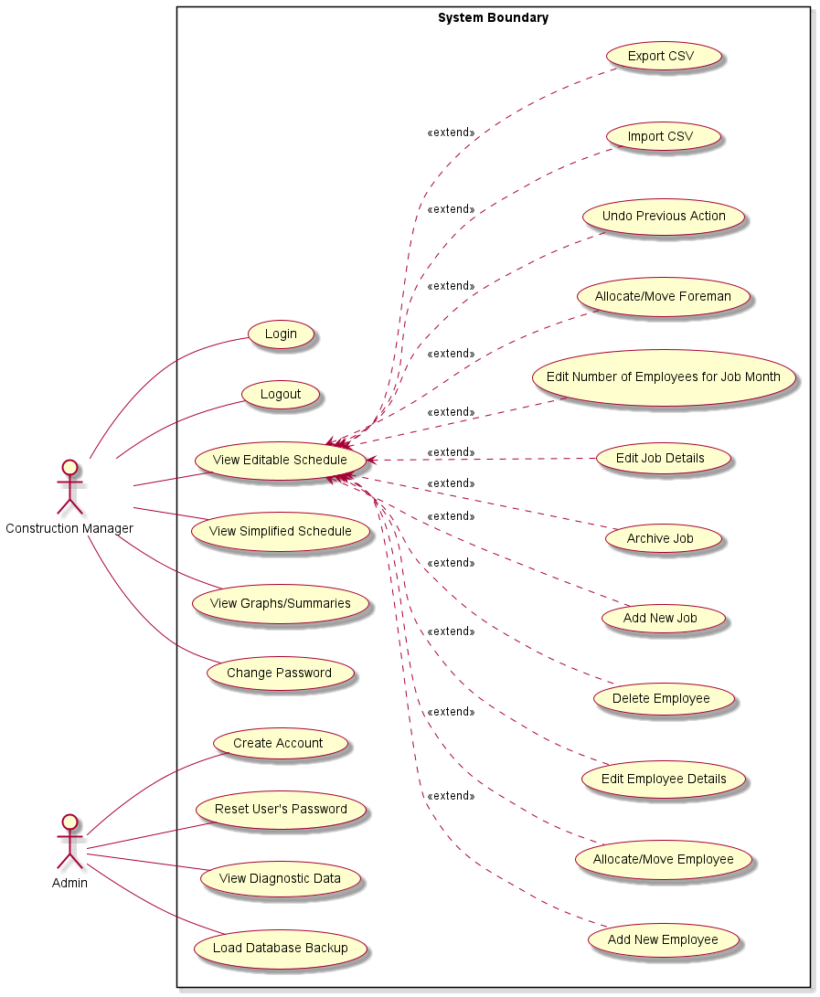
Old use case diagram
22 Use Cases Total
Notes:
(Adam)
This is our old use case diagram. When we started this project, the use cases that we had thought up was fairly basic, we knew the essential functions that we had to implement such as adding, editing, and moving employees and jobs; but as we began to really develop the project, we realised that there were a lot of use cases that we hadn’t yet anticipated.
Next: Adam, new use case diagram

Slide 11
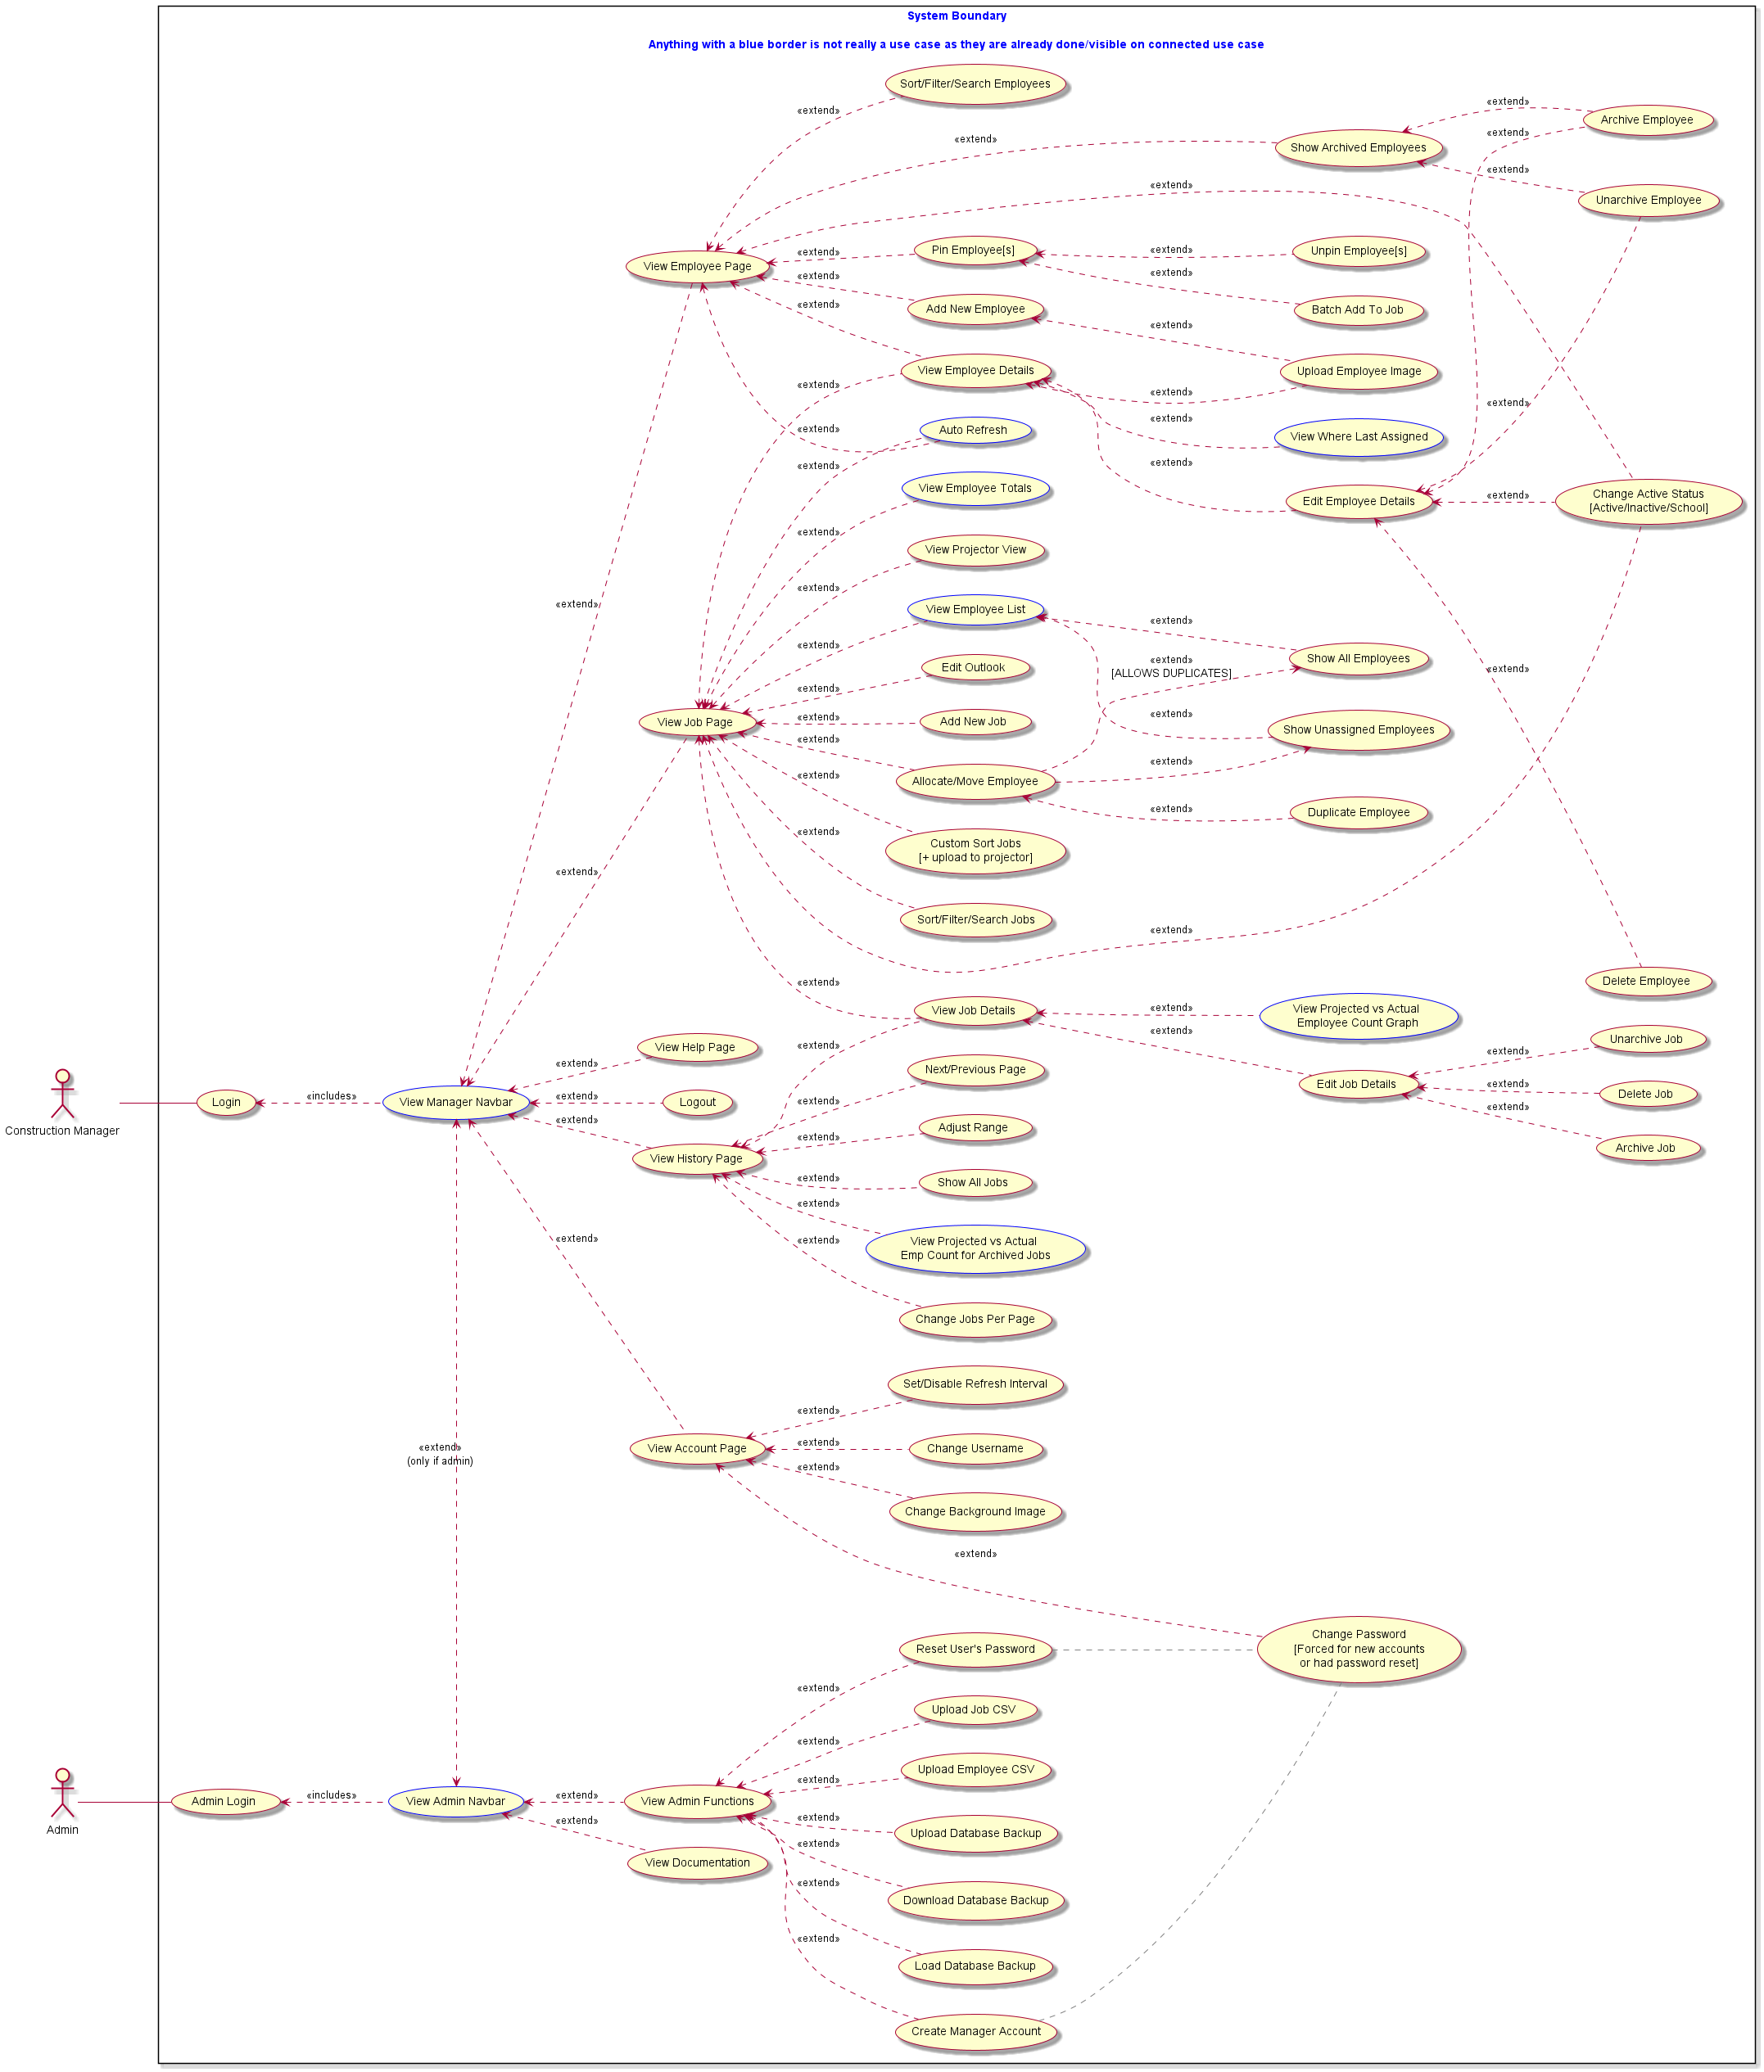
New use case diagram
53 Use Cases Total (At Least 60 Distinguished Features)
Notes:
(Adam) THIS is our new use case diagram. As you can see, we discovered a lot of new ones!
There’s at least 20 new use cases here, as well as several other distinguished features, like auto refresh.
Some are from client requests,
though many were ones we just realised during development that the application can’t go without,
Though this was simply the nature of our agile process.
Next: Adam, enlarge new use case diagram

Slide 12
New use case diagram
Notes:
(Adam) THIS is our new use case diagram. As you can see, we discovered a lot of new ones!
There’s at least 20 new use cases here, as well as several other distinguished features, like auto refresh.
Some are from client requests,
though many were ones we just realised during development that the application can’t go without,
Though this was simply the nature of our agile process.
Next: Adam, architecture diagram

Slide 13
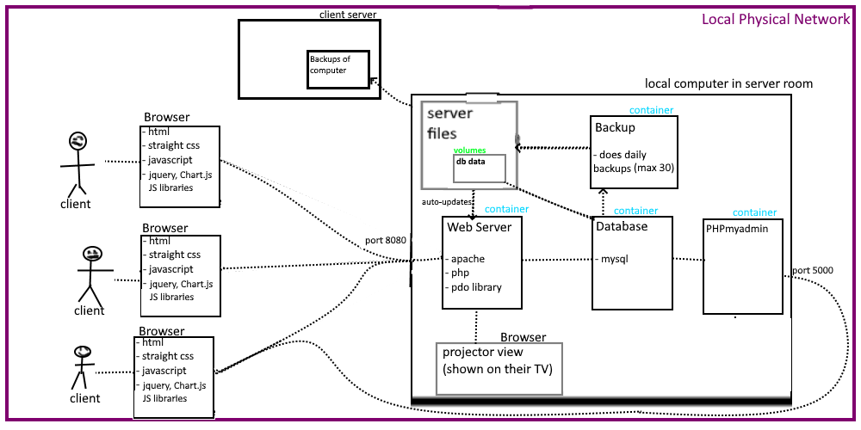
Architecture Diagram
Notes:
(Adam) Moving on to the architecture diagram, this is a high level overview of the main components of the system and how they connect. As we can see here, the clients access the system on their local server from their web browser. One of the requirements for this project is that the data of the system is secure from the outside world, and since only the managers would be accessing this information, and only within their office, the system is confined to the local network and cannot be accessed from the internet.
Next: Adam, architecture diagram - MVC

Slide 14
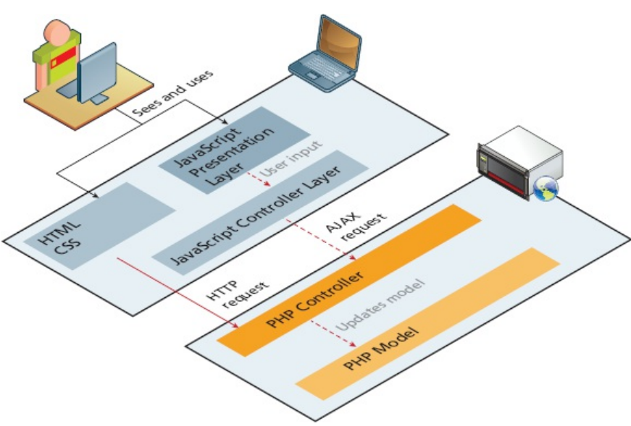
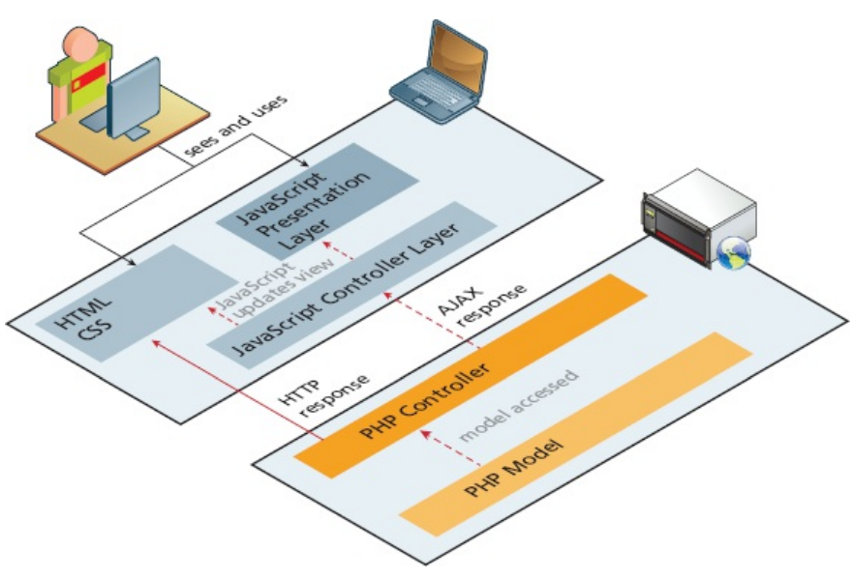
Architecture Diagrams - MVC
Credits: Figure 17.14/15 from Fundamentals of Web Development 2nd edition, Randy Connolly & Ricardo Hoar, 2018.
Notes:
(Adam) Here’s another more detailed view of our system’s Model View Controller component. It has a mysql Model, an html and javascript View, a PHP and JavaScript Controller; where the JavaScript takes care of the asynchronous component through AJAX calls.
Most of the application was made using these AJAX calls to improve the responsiveness of the website.
Next: Jordan, with the datataflow diagram

Slide 15
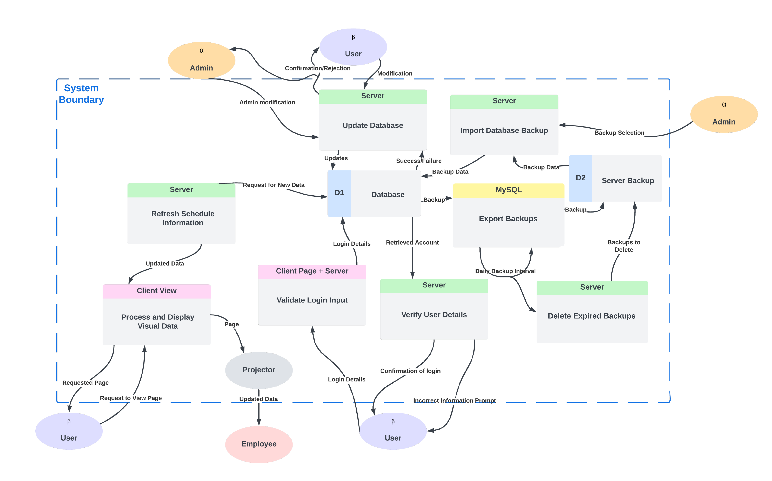
How the Data Flows
Notes:
(Jordan)
This is our Data Flow Diagram, a high level view of the ways a User can interact with the system and the following flow of data. The bottom middle showcases how our login function works, which is quite standard. The bottom left corner showcases the main use case for the board being a real-time look at the current state of the system based on the previous whiteboard. The top shows how data flows while editing the board and the left shows how an admin user may interact with backups
Next: Eddy, testing section cover page
DON’T SAY UM

Slide 16
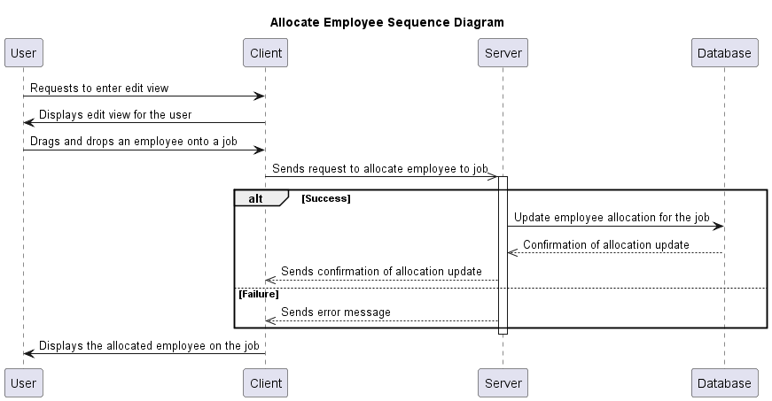
Sequence Diagram Example
Notes:
This last diagram is an example of a sequence diagram for allocating an employee within the program. A sequence diagram is an interaction diagram that shows how processes operate with one another and in what order. It depicts the interactions between objects and the sequence of messages exchanged between them to carry out a specific functionality.
In this example, we can see that to allocate an employee, the user drags and drops an employee onto a job, which then causes the client machine to send a request to the server to allocate that employee to the job they were dropped on. The server would process some error checking to make sure that the action is doable and then send an instruction to the database to make the change. If a problem was found with the request, such as if the client had outdated information displayed on their screen, an error message would be returned to the client machine which then would inform them of the problem.

Slide 17
Testing
Unit testing, Integration testing, User testing, Regression testing
Notes:
Eddy
Another aspect of this project was the testing that we made to make sure that each component of the system is functioning properly.
Next: Eddy, testing workflow

Slide 18




Testing workflow
Notes:
Eddy
We adopted unit, integration, and regression testing for the project by using PHP unit, a testing framework, and Drone CI, an automated test runner. As we were using Git and Github for this project, each time that we wanted to make changes to the repository by opening a pull or merge request, the automated testing function would run all the tests to make sure that the new code did not break any previous working code.
Next: Eddy, testing logs

Slide 19
Testing logs
Requirement |  | Type of test Unit test(UNT), Integration test(IT), User test(UT) | Pass/Fail | Contributor
Add New Job
1.1 | The system presents a form to prompts the user to enter the name, duration (start month, end month), and the project manager (optional field) of the new job/project. | UNT, IT, UT | Pass | Eddy, Adam
1.2 | The system validates the entered information to ensure it meets any defined constraints. | UNT, IT, UT | Pass | Eddy, Adam
1.3 | The system stores the job/project details in the database. | UNT, IT, UT | Pass | Eddy, Adam
 | Add New Employee
2.1 | The system presents a form to prompts the user to enter the details of the new employee. | UNT, IT, UT | Pass | Eddy, Adam
2.2 | The system validates the entered information to ensure it meets any defined constraints. | UNT, IT, UT | Pass | Eddy, Adam
2.3 | The system stores the employee details in the database. | UNT, IT, UT | Pass | Eddy, Adam
 | Allocate Employee
3.1 | User drags employee from job to other job | UNT, IT, UT | Pass | Edwin
3.2 | System visually keeps the change. | UNT, IT, UT | Pass | Edwin
3.3 | System updates the database with the change | UNT, IT, UT | Pass | Edwin
Notes:
Eddy
In this slide, you can see some of the testing logs indicating that the tests were successful.
Next: Eddy, user testing

Slide 20
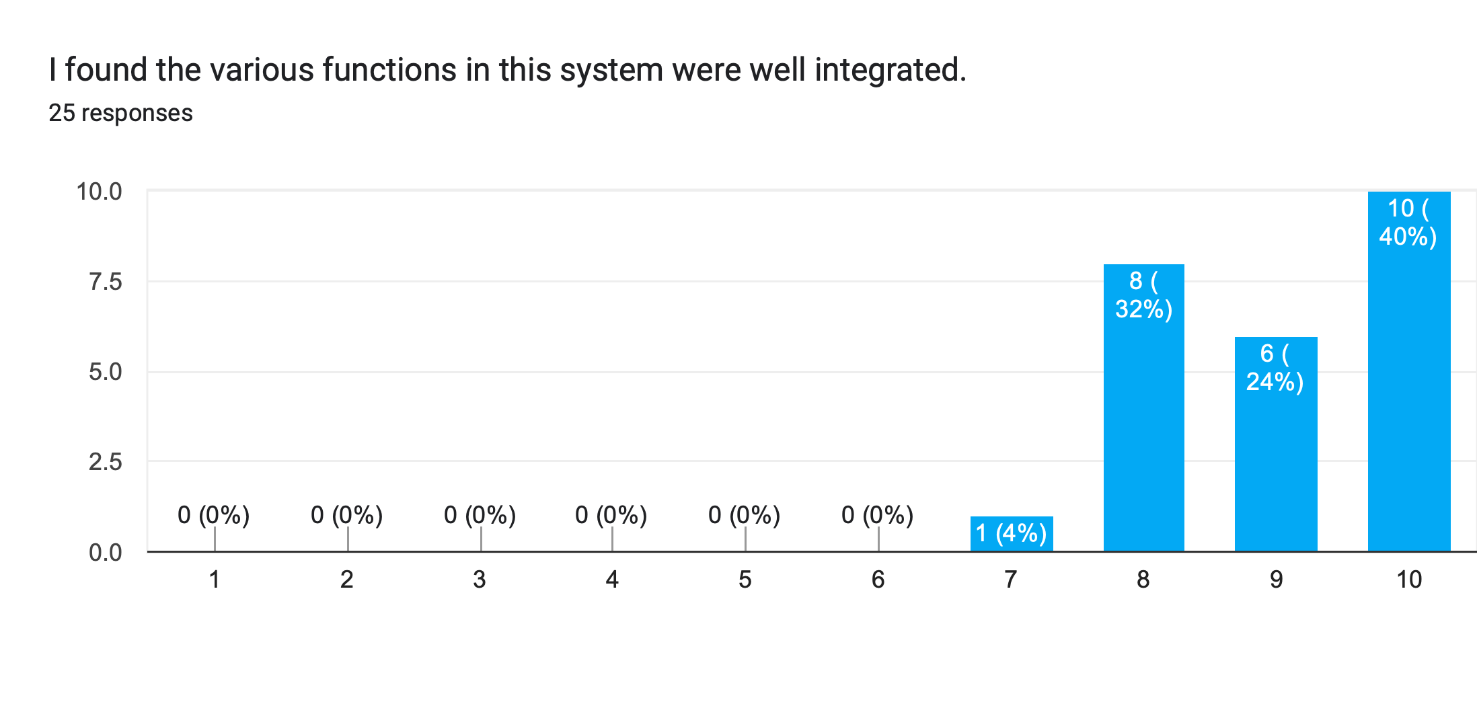
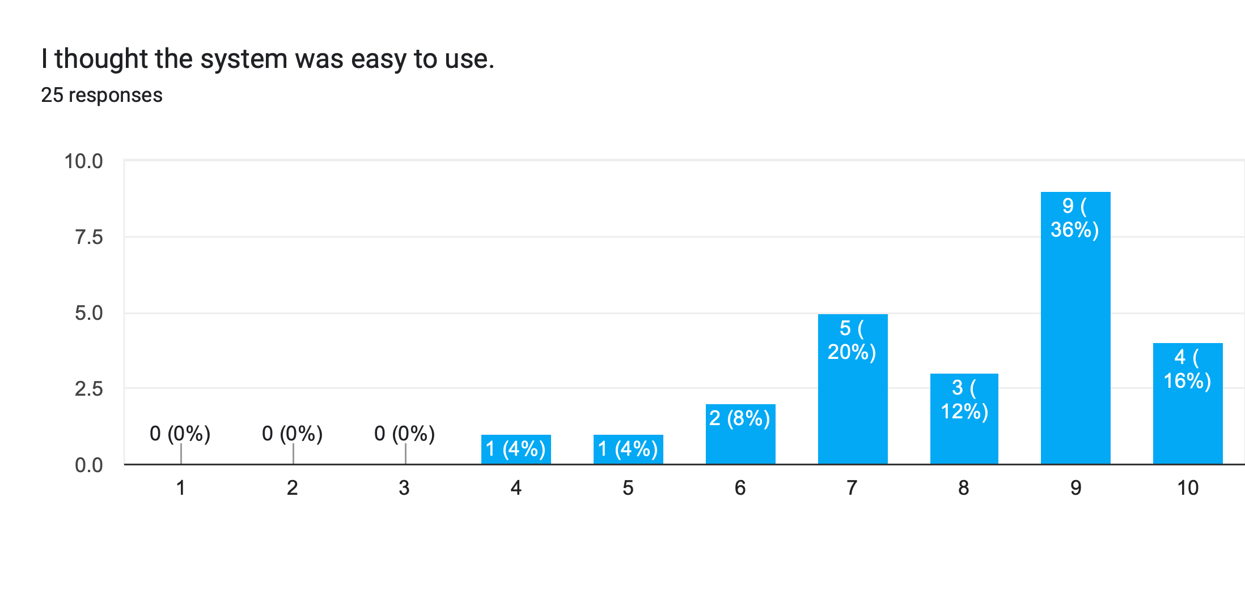
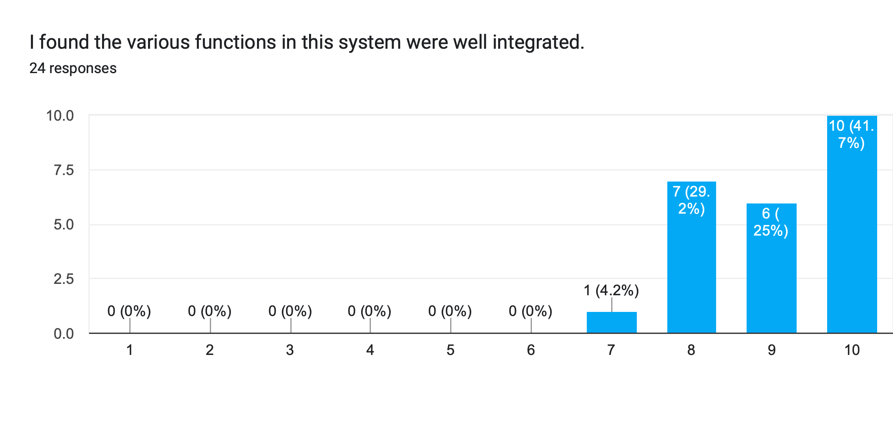
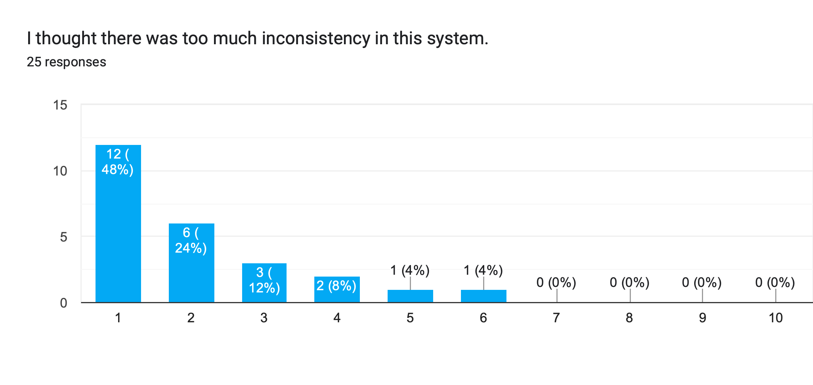
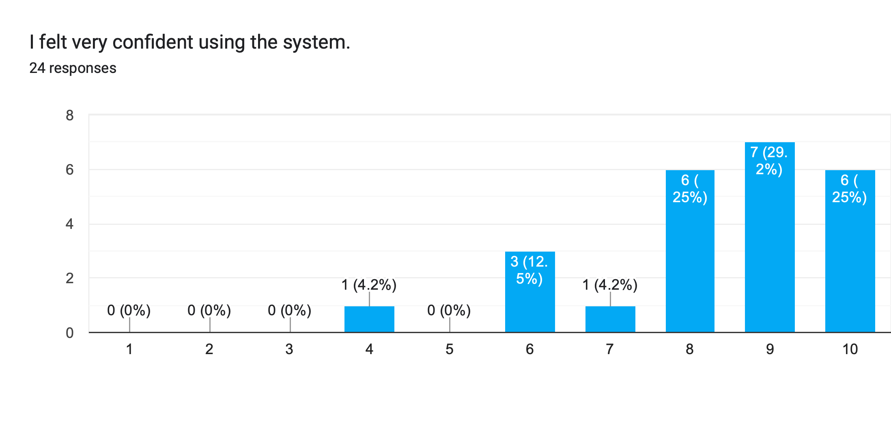
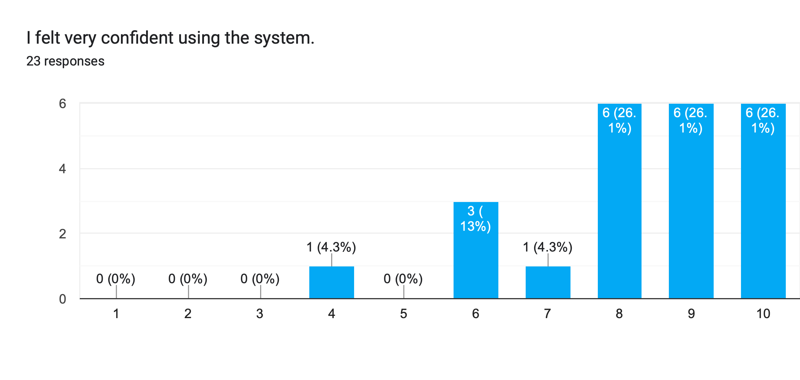
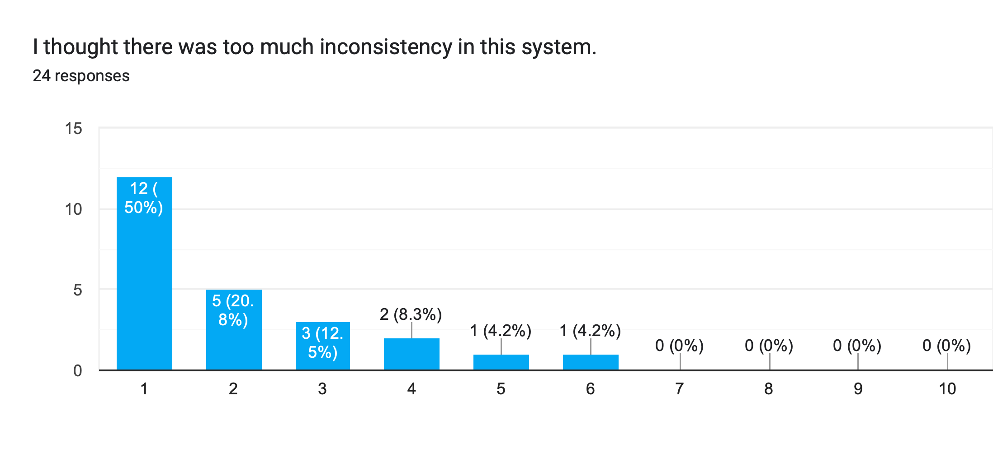
Notes:
Eddy
The other method of testing that we conducted was user testing. This method of testing involves getting actual people to use the system and provide feedback on how they felt while using the system. During this phase of testing, we collected 25 responses from students and 3 responses from the client. As you can see on the charts, the testers agreed that the system is easy to use, the functions in the system are well integrated, and that there is very little inconsistency in the system. The vast majority of the testers agreed that they felt very confident using this system that we made.
Next: Adam, workflow and deployment section cover page

Slide 21
Workflow and Deployment
Notes:
Adam
Next, we would like to summarize our workflow during this project.
Next: Adam, workflow

Slide 22
Workflow
Gather client requirements.
Bimonthly client meeting for updates and feedback.
Weekly professor meeting.
Regular online group meetings (and constant text chat).
Report on Kanban board and Clockify.
Notes:
To ensure that the project progressed smoothly, we first had to understand the project requirements from the client. After that, during the development phase of the project, we regularly presented our progress to the client through bimonthly meetings and gathered feedback in order to tailor the final product to their needs. One of the notable pieces of feedback that we got was that the client wanted a way for them to sort the list of jobs in a custom order since they liked to group relevant jobs together rather than sorting them by name or by time created.
We also met with our professor regularly so that he can point out anything that the client or ourselves might not have noticed. And the final components of our workflow is that the developers kept in almost constant contact through online messaging, and kept track of who was doing what via the Kanban board (also known as a to-do list), and the time tracking program clockify.

Slide 23
Workflow
Create feature branch
Write tests for feature
Code feature
Create pull request
Code review and merge
Refactor
Tests auto-run (continuous integration)
Tests pass
Notes:
(Adam) Here is a rough breakdown of our workflow that we used.
We mainly adhered to Kanban style development process, where we first write the tests before implementing the feature, which helps reduce bias in our tests.
We also do mandatory code reviews, which helps reduce bugs and improve code quality.
Next: Adam, deployment

Slide 24
deployment
Install necessary software on client hardware
Install project
Boot software up
Bug-fix/test
Deploy to server for meeting demo
Notes:
(Adam)
During development, we deployed a beta version of the software on Jordan’s personal server. This allowed us to get early, yet somewhat limited feedback from our client.
When it came to actually deploying the software on their server,
we installed docker, downloaded the project off of github,
Then, it was a as simple as booting up the docker containers off of our “deployment” branch.
Next: Jordan, lesson learned

Slide 25
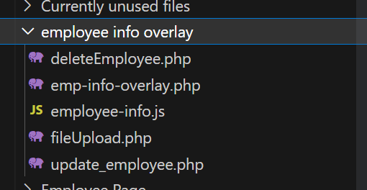
Lesson Learned
Improvements:
Set up continuous deployment early
No established naming scheme (had camelCase, kabob-case, snake_case, and Title Case)
Started testing too late
No front-end testing framework
What to keep the same:
Client meetings frequency
Requiring code reviews
Kanban
Notes:
Jordan
As the course went on, we learned a lot about what we did well and what we could improve on, for example;
I hosted a beta version of the website on my computer, but that was not always running nor up-to-date. If we had set up continuous deployment earlier, where a beta version was hosted on their system that would auto-update, that would have allowed us to get more client feedback earlier. We never established a naming convention for functions, which resulted in our project having a ton of different conventions. This could have been fixed with a linter
PHPUnit should have been set up earlier
We should’ve introduced a front-end testing framework
As for what to we’d keep the same: - The biweekly client meetings worked great as we could ask for questions and feedback
- Requiring code reviews helped unveil a lot of bugs or possibly problematic code
Using the kanban process worked quite well for us, as it allowed us to work on what we think we can do or would like to do
Next: Jordan, summary and potential future features
DON’T SAY UM

Slide 26
Summary and Potential Future features
Summary
We deployed the software last week. Hooray!
The software is feature complete and our client is happy!
Client testing so far has indicated that the software is stable.
Potential Future Add-ons
Automated statistic analysis – Automate manpower projections
Internet portal for employee – Alternative to manually messaging employees
Detailed user input tracking to allow for “actions log” and “advanced undo”
Adding new graphs
Notes:
Jordan
The client has been testing the software for the past few days and so far, it seems that it is working as intended. There isn’t any more work to be done on the project, but there were a few features that we thought up that could be considered in the future to add more functionality to the system.
-Automatic projection generation
-Scheduling software for employees
-Undo Log
Next: Jordan, project management section cover page
DON’T SAY UM

Slide 27
Project Management
Notes:
Jordan
Next: Jordan, github stats
DON’T SAY UM

Slide 28
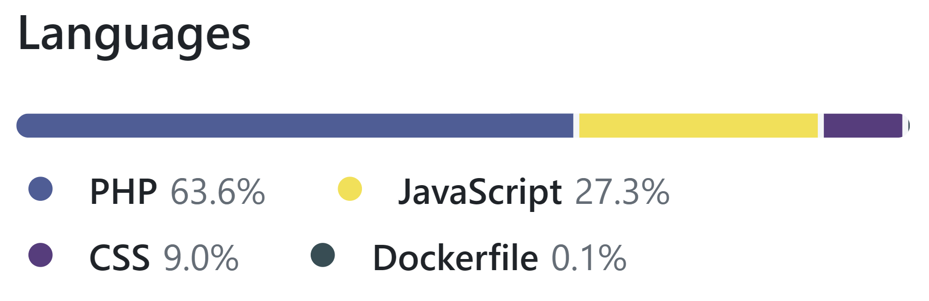
GitHub Stats
102 pull requests merged
228 tracked tasks completed
94 branches
>1300 commits
Drone builds: 509
Notes:
Jordan
As mentioned earlier, all features went through pull requests alongside integration and unit testing. PHP was clearly the most used language which makes sense given the nature of the project where PHP did most of the heavy lifting.
We merged 102 pull requests and got 228 tracked tasks completed.
Next: Jordan, feature list
DON’T SAY UM

Slide 29
Feature list
 | Features | Status | Note
1 | View Job Page | completed
2 | Allocate/Move Employee | completed
3 | Add New Job | completed
4 | Add New Employee | completed
5 | Edit Outlook (Projection) | completed
6 | View Employee List | completed | not really use case
7 | Show All/Unassigned Employees - Job page - via employee list | completed
8 | Change Active Status [Active/Inactive/School] | completed
9 | View Employee Details | completed
10 | Edit Employee Details | completed
11 | View Job Details | completed
12 | Edit Job Details | completed
13 | Delete Employee | completed
14 | Delete Job | completed
15 | View Employee Totals | completed | not really use case
16 | Auto Refresh | completed | not really use case
17 | Duplicate Employee | completed
18 | Login/Admin Login | completed
19 | Logout | completed
20 | View Manager/Admin Navbar | completed | not really use case
21 | View Account Page | completed
22 | Change Password | completed
23 | View Presenter View | completed
24 | View Admin Functions | completed
25 | Create Manager Account | completed
26 | View Employee Page | completed
27 | Archive Job | completed
28 | Unarchive Job | completed
29 | Show Archived Employees | completed
30 | Archive Employee | completed
31 | Unarchive Employee | completed
32 | Load Database Backup | completed
33 | Reset User's Password | completed
34 | Sort/Filter/Search Employees | completed
35 | Sort/Filter/Search Jobs | completed
36 | Upload Employee Image | completed
37 | Custom Sort Jobs [+ upload to projector] | completed
38 | View Projected vs Actual Employee Count Graph | completed | not really use case
39 | View Where Last Assigned | completed | not really use case
40 | View History Page | completed
41 | View Projected vs Actual Employee Count for Archived Jobs - History Page | completed | not really use case
42 | Show All Jobs - History Page | completed
43 | Set/Disable Refresh Interval | completed
44 | View Help Page | completed
45 | Pin Employee[s] | completed
46 | Batch Add to Job | completed
47 | Unpin Employee[s] | completed
48 | Download Database Backup | completed
49 | Upload Database Backup | completed
50 | Adjust Range - History Page | completed
51 | Next/Previous Page + Change Jobs Per Page - History Page | completed
52 | Change Username | completed
53 | Upload Job CSV | completed
54 | Upload Employee CSV | completed
55 | View Documentation | completed
56 | Change Background Image | completed
57 | Undo | removed | Too much opportunity cost
58 | Export CSV | removed | Not needed
59 | View Diagnostic Data | removed | Not really needed
Notes:
Jordan
Here is a list of features. (excited)
As the project went on we suffered from a little bit of feature creep as noted in the earlier Use Case Diagrams. However, these all ended up being required features for the product that the client and us foresaw.
Our software is actually feature complete, and the client is happy with it.
Next: Jordan, burnup chart
DON’T SAY UM

Slide 30
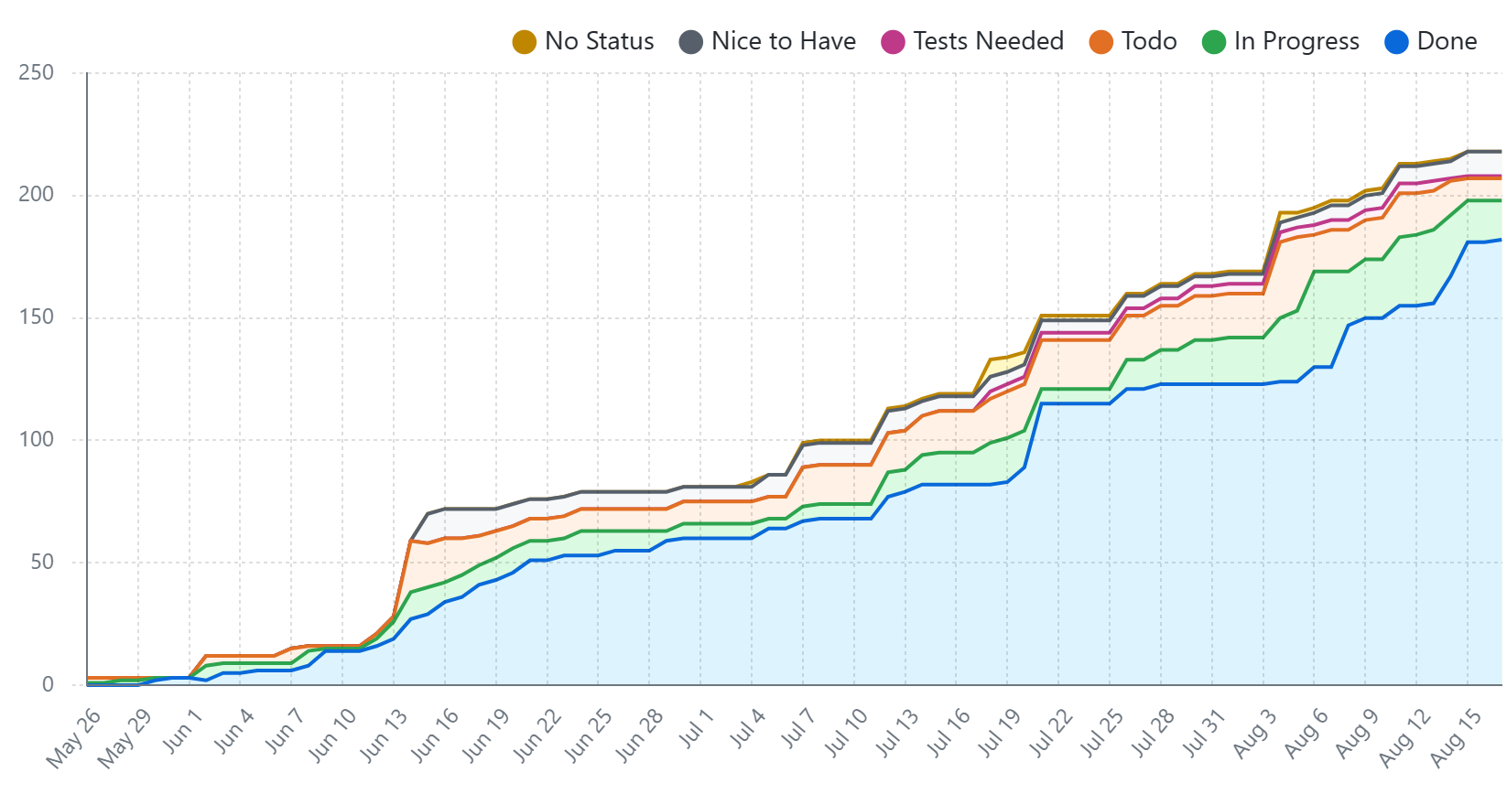
Burnup Chart
Notes:
Jordan
This is from Aug 15, when doing the team report for Wed Aug 16. Gives “Unable to render chart” error now, sadly. If you can render it, please paste the latest one.
Mention that not accurate.
This shows our slow ascent into madness, an improvement would be to create all ‘todo’ items ahead of time. However, this proved quite difficult with the dynamic nature of agile development.
Although it doesn’t show it, we did complete all of these tasks.
Next: Jordan, time tracking summary
DON’T SAY UM

Slide 31
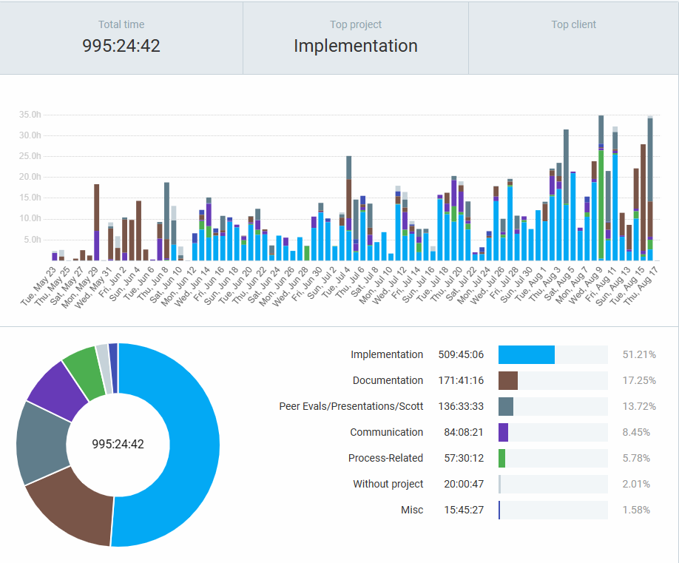
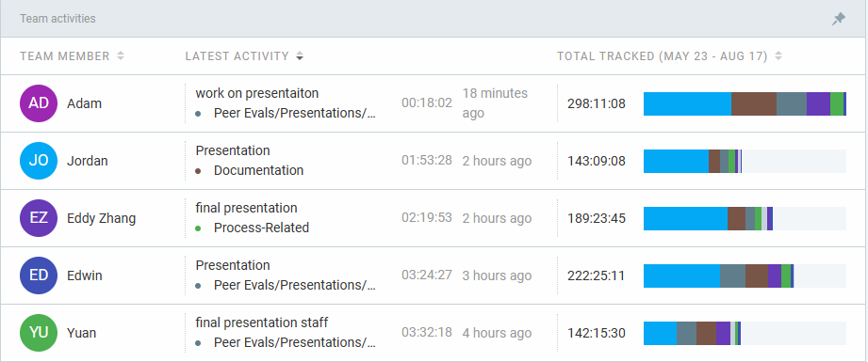
Time Tracking Summary
Notes:
Start date: May 23 (to readd screenshot)
Jordan
As you can see, according to our Clockify, we have put in a total of at least 980 hours into the project, which is likely a bit of an underestimate as we didn’t all use it from the beginning.
Over half of this was on Implementation, cool!
Next: Jordan, “thank you for your time” page
DON’T SAY UM

Slide 32
Thank You For Your Time!
Notes:
Jordan
Thank you for taking the time to view our presentation.
Next: Jordan, “question?” page

Slide 33
Questions?
Please :)
Notes:
Jordan
We would love to hear any questions you may have.
done

